Slide 1
Bootstrap
Bootstrap Basics
Notes:
Add instructor notes here.

Slide 2

Lesson Objectives
Bootstrap Grid System
Bootstrap Basic components
Notes:
Add instructor notes here.

Slide 3
2.1: Bootstrap grid system Grid System in Bootstrap
Grid systems are used for creating page layouts through a series of rows and columns to wrap the site content.
Primarily grids are about providing structure. For web designers a grid defines the horizontal and vertical guidelines for arranging content and enforcing margins.
Grids also define an intuitive structure for viewers because it's easy to follow a left to right or a right to left flow of content moving down the page.
The grid won't be visible with border like table, but it exists behind the scenes to provide order alignment and consistency.
Bootstrap includes a grid system amongst its features.
Notes:
Add instructor notes here.

Slide 4
2.1: Bootstrap grid system Bootstrap grid system
Bootstrap includes a responsive, mobile first fluid grid system that appropriately scales up to 12 columns as the device or viewport size increases.
Every row in Bootstrap consists of 12 columns.
Rows must be placed within a .container class for proper alignment and padding.
Use rows to create horizontal groups of columns.
Content should be placed within columns, and only columns may be immediate children of rows.
Predefined grid classes like .row and .col-4 are available for quickly making grid layouts.
Notes:
Grid System in Bootstrap 4:
Bootstrap's grid system is built with flexbox and allows up to 12 columns across the page.(In general this means a move away from floats and more across bootstrap’s components.)
It uses a series of containers, rows, and columns to layout and align content.
Add instructor notes here.

Slide 5
2.1: Bootstrap grid system Bootstrap grid system – Contd…
Grid columns are created by specifying the number of twelve available columns you wish to span. For example, three equal columns would use three .col
Columns create gutters (gaps between column content) via padding. That padding is offset in rows for the first and last column via negative margin on .rows
Grid has 5 sizes
xl : indicates that the extra large grid displaying. The grid stacks horizontally
>= 1200px.
lg: : indicates that the extra large grid displaying. The grid stacks horizontally >=992px
md : indicates that the medium grid displaying. The grid stacks horizontally >=768px sm : indicates that the small grid displaying. The grid stacks horizontally >=576px
No infix to specify extra small grid displaying(-xs is removed from classes). This is now by default and stacks horizontally addressing smaller devices at 576px and below .
Notes:
Add instructor notes here.

Slide 6
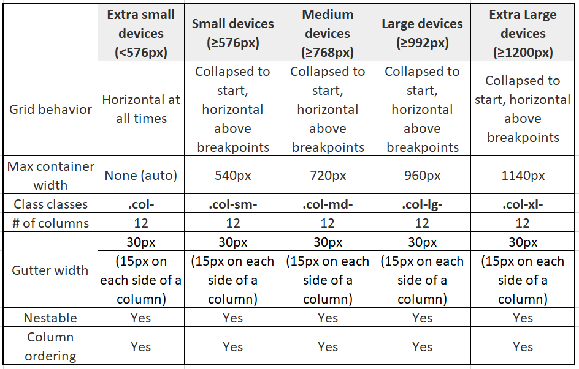
2.1: Bootstrap grid system Grid Options
Notes:
The slide shows new revamped grid structure(5 tier) details in Bootstrap 4.
Add instructor notes here.

Slide 7
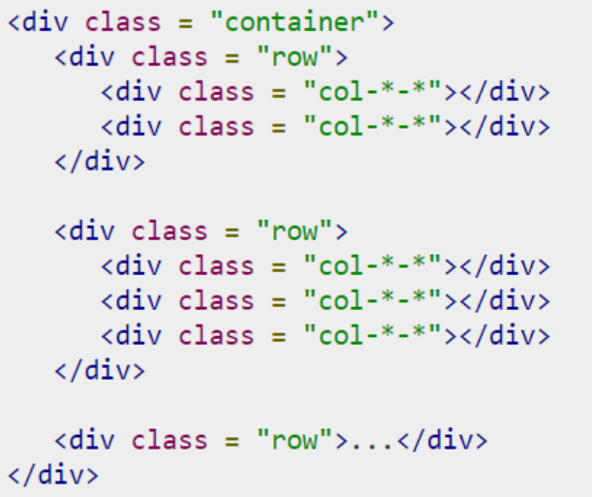
2.1: Bootstrap grid system Basic Grid Structure
Notes:
Basic Grid Structure Bootstrap 4:
The first star (*) represents the responsiveness: sm, md, lg or xl, while the second star represents a number, which should add up to 12 for each row.
Add instructor notes here.

Slide 8
2.1: Bootstrap grid system Bootstrap grid sizes
.col-xx-6 |  |  |  | .col-xx-6
.col-xx-4 |  |  | .col-xx-4 |  | .col-xx-4
.col-xx-3 |  | .col-xx-3 |  | .col-xx-3 |  | .col-xx-3
.col-xx-2 | .col-xx-2 |  | .col-xx-2 | .col-xx-2 | .col-xx-2 |  | .col-xx-2
Notes:
Add instructor notes here.

Slide 9
Demo
GridSizes
Notes:
Add instructor notes here.

Slide 10
2.1: Bootstrap grid system Bootstrap grid sizes – using Offset
.col-xx-10 |  |  |  |  |  |  |  |  |  | .col-xx-2
 |  | .col-xx-8 .col-xx-offset-2
.col-xx-6 |  |  |  |  |  |  |  | .col-xx-3 .col-xx-offset-2
.col-xx-3
Note: Offset will be added to the left.
Notes:
Add instructor notes here.

Slide 11
Demo
GridSizes-Offset
Notes:
Add instructor notes here.

Slide 12
2.1: Bootstrap grid system Multiple Grid
.col-md-8 .col-xs-12 | .col-xs-6 .col-md-4
Notes:
Add instructor notes here.

Slide 13
Demo
MultipleGrid
Layout
Notes:
Add instructor notes here.

Slide 14
2.2: Bootstrap Basic Components Helper Classes & Responsive Utilities
Close Icon : It is used to dismiss models and alerts
<button type="button" class="close" aria-hidden="true">&times;</button>
Dropdown toggles no longer require an explicit <span class="caret"></span>; this is now provided automatically via CSS’s ::after on .dropdown-toggle.
Quick floats : To float an element left or right with a class
Added .float-{sm,md,lg,xl}-{left,right,none} classes for responsive floats and removed .pull-left and .pull-right since they’re redundant to .float-left and .float-right.
Showing and hiding content
Made display utilities responsive (e.g., .d-none and d-{sm,md,lg,xl}-none).
Dropped the bulk of .hidden-* utilities for new display utilities. For example, instead of .hidden-sm-up, use .d-sm-none.
Notes:
Utilities: Bootstrap 4 is a major rewrite of the entire project. Most of the existing classes are rewritten to match up with the new flexbox support.
Add instructor notes here.

Slide 15
2.2: Bootstrap Basics Helper Classes & Responsive Utilities
Work with Images : We can apply simple styles to images like rounded corners, circle images & padding with gray border which fits all sizes
<img src="images/image.jpg" alt="Image" class="rounded"/>
<img src="images/image.jpg" alt="Image" class=“rounded-circle"/>
<img src="images/image.jpg" alt="Image" class="img-thumbnail"/>
<img src="images/image.jpg" alt="Image" class=“img-fluid"/>
Center content blocks : To set an element to center
<div class=" mx-auto" style="width:150px;">Centered-Content</div>
Responsive utilities : It is used for showing and hiding content by device via media query combined with extra large, large, medium, small & extra small devices
Use class .d-block and .d-{sm,md,lg,xl}-block to se visibility as per breakpoints.
Notes:
Add instructor notes here.

Slide 16
Demo
HelperClasses-ResponsiveUtilities
Notes:
Add instructor notes here.

Slide 17

2.2: Bootstrap Basics Working with Buttons
We can use <a>, <button> or <input type="button"/> with 'btn' class to create a bootstrap button.
<a class="btn" href="#">Link Button</a>
<button class="btn">Button</button>
<!-- recommended for browser consistency -->
<input type="button" class="btn" value="button"/>
Notes:
Add instructor notes here.

Slide 18
2.2: Bootstrap Basics Working with Buttons
Bootstrap provides following options to apply styles to the button
<button class="btn btn-default">Default</button>
<button class="btn btn-primary">Primary</button>
<button class="btn btn-success">Success</button>
<button class="btn btn-info">Info</button>
<button class="btn btn-warning">Warning</button>
<button class="btn btn-danger">Danger</button>
<button class="btn btn-link">Link</button>
Notes:
Add instructor notes here.

Slide 19
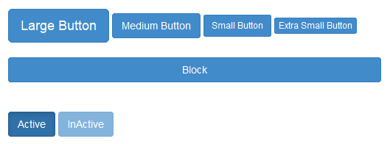
2.2: Bootstrap Basics Working with Buttons
Button has following sizes and states
<button class="btn btn-primary btn-lg">Large Button</button>
<button class="btn btn-primary btn-md">Medium Button</button>
<button class="btn btn-primary btn-sm">Small Button</button>
<button class="btn btn-primary btn-xs">Extra Small Button</button>
<button class="btn btn-primary btn-block">Block</button>
<button class="btn btn-primary btn-md active">Active</button>
<button class="btn btn-primary btn-md disabled">InActive</button>
Notes:
Add instructor notes here.

Slide 20
Demo
Buttons
Notes:
Add instructor notes here.

Slide 21


2.2: Bootstrap Basics Icon Font
Until version 3 Bootstrap was having support for Glyphicons (a library of monochromatic icons and symbols).
Bootstrap 4 has dropped the support for Glyphicons icon font. If you need icons, some options are:
the upstream version of Glyphicons
Octicons
Font Awesome
Font Awesom is most popular icon set and toolkit. You can easily download, configure the relative path with project and start using them.
<div>
<span class="fas fa-search"></span>
<button class="btn btn-primary">
<span class="fas fa-sync"/> Refresh
</button>
</div>
Notes:
Using Web Fonts with CSS
Download font awesome package. Unzip the downloaded file and expand to see the structure.
The /css/all.css file contains the core styling plus all of the icon styles that you’ll need when using Font Awesome. The /webfonts folder contains all of the typeface files that the above CSS references and depends on.
Copy the entire /webfonts folder and the /css/all.css into your project’s static assets directory (or where ever you prefer to keep front end assets or vendor stuff).
Add a reference to the copied /css/all.css file into the <head> of each template or page that you want to use Font Awesome on.(Please refer the demo)
)
Add instructor notes here.

Slide 22
Demo
FontAwesom
Notes:
Add instructor notes here.

Slide 23
2.2: Bootstrap Basics List
Bootstrap provides following options to apply styles to the List
Use the class .list-unstyled to remove numbering / bullet in the <ol> or <ul> element
Use the class .list-inline to <ul> create single list then use class .list-inline-item <li> to place the items.
To create a list group use the class .list-group to <ul> and .list-group-item <li> element
To add a badge component to any list group item add the <span class="badge"> with in the <li> element with as per required positioning.(place it on either left or right side of the element)
Use the .badge-pill modifier class to make badges more rounded (with a larger border-radius and additional horizontal padding).
Notes:
<span class="badge badge-pill badge-light">Light</span> - .badge-light modifier class helps to understand context of use. Otherwise badges may seem like random additional words or numbers at the end of a sentence, link, or button
Add instructor notes here.

Slide 24

2.2: Bootstrap Basics List
We can add custom content to the list group using the following code snippet
<div class='list-group'><a href='#' class='list-group-item active'>
<h4 class='list-group-item-heading'>IGATE Corporate University</h4>
<p class='list-group-item-text'/>IGATE Training Division</p></a></div>

Slide 25
Demo
List
Notes:
Add instructor notes here.

Slide 26
2.2: Bootstrap Basics Tables
Bootstrap provides a clean layout for building tables. Following classes can be used to apply styles over the table.
table : To create a basic Bootstrap style table which takes 100% of the width of its container, and it also adds in some horizontal dividers.
table-striped : Provides a striping effect for the alternate rows in a table.
table-bordered : Provide a border to the table
table-hover : To add a slight hover effect as the mouse moves over a table row.
table-sm : It removes most of the cell padding and make the table a little more streamlined.
table-responsive : It makes the table scroll horizontally to view the contents in small devices
Contextual classes : table-active, table-success, table-warning and table-danger is used to apply background color for the table rows or individual cells.
Notes:
Add instructor notes here.

Slide 27
Demo
Tables
Notes:
Add instructor notes here.

Slide 28
2.2: Bootstrap Basics Forms
Bootstrap 4 provides 2 types of form layouts
Stacked (full-width) form
Inline Form
Vertical Form
Add a role form to the parent <form> element
Add the class .form-control to form elements and wrap labels and controls in a <div> with class .form-group
Inline Form
Add the class .form-inline to the <form> elements
Add the class .form-control to form elements and wrap labels and form elements in a <div> with class .form-group
Add the class .sr-only to hide the labels of the inline forms
Notes:
.form-horizontal class has been dropped in Bootstrap 4. You can use Bootstrap's grid classes to create horizontal forms. Just specify how many columns each element should span. Specifically, add a .row class to the .form-group and a .col-*-* or .col-* class for each column.
You should also add Bootstrap's .col-form-label class to the <label> element in order to vertically center the label in relation to textual input elements.
Add instructor notes here.

Slide 29
2.2: Bootstrap Basics Forms
Horizontal form
.form-horizontal class has been dropped in Bootstrap 4.
You can use Bootstrap's grid classes to create horizontal forms. Just specify how many columns each element should span. Specifically, add a .row class to the .form-group and a .col-*-* or .col-* class for each column.
You should also add Bootstrap's .col-form-label class to the <label> element in order to vertically center the label in relation to textual input elements.
Validation States : Bootstrap includes validation styles for error, and success message. To use add the classes .is-valid and .is-invalid respectively.
Help Text : Use .form-text (previously known as .help-block in v3)class to have block level help text for the form input controls.
Notes:
Associating help text with form controls
Help text should be explicitly associated with the form control it relates to using the aria-describedby attribute. This will ensure that assistive technologies – such as screen readers – will announce this help text when the user focuses or enters the control.
For example:
<label for="inputPassword">Password</label> <input type="password" id="inputPassword" class="form-control" aria-describedby="passwordHelpBlock"> <p id="passwordHelpBlock" class="form-text text-muted"> Your password must be 8-20 characters long, contain letters and numbers, and must not contain spaces, special characters, or emoji. </p>
Add instructor notes here.

Slide 30
Demo
Forms
Notes:
Add instructor notes here.

Slide 31
2.2: Bootstrap Basics Typography
Using typography feature of Bootstrap we can create headings, paragraphs, lists and other inline elements.
All html headings(h1 to h6) are styled in bootstrap.
By adding .lead class to the paragraph, we can have a larger font size, lighter weight, and a taller line height.
<em> tag emphasizes a text in italics and <strong> tag makes the text bold
<small> tag sets text at 85% the size of the parent
<abbr> styles the element with a light border along the bottom and reveals the full text on hover
<address> styles the contact information on web page. We need to use line breaks to break the lines because <address> default to display:block
text-left, text-center, text-right, text-muted, text-primary, text-success, text-info,text-warning and text-danger class used to apply the styles to the text
Notes:
Add instructor notes here.

Slide 32
Demo
Typography
Notes:
Add instructor notes here.

Slide 33

Summary
Bootstrap includes a responsive, mobile first fluid grid system that appropriately scales up to 12 columns as the device or viewport size increases.
Bootstrap provides 2 form layouts Vertical Form (default), Inline Form. Horizontal Form can be created by using grid system.
Bootstrap provides a clean layout for building tables
Using typography feature of Bootstrap we can create headings, paragraphs, lists and other inline elements.
Notes:
Add the notes here.
Add instructor notes here.

